Slide 1
LAUNCH meeting
Heidelberg, Germany, April 28-29, 2006
Nuclear Matrix elements for the 0νββ-decay and double electron capture
Fedor Šimkovic
Comenius University, Bratislava

Slide 2
OUTLINE
Introduction
Shell model and the QRPA NME
The 0nbb-decay within the SRQRPA
Work in progress
0νECEC-decay
Conclusions

Slide 3
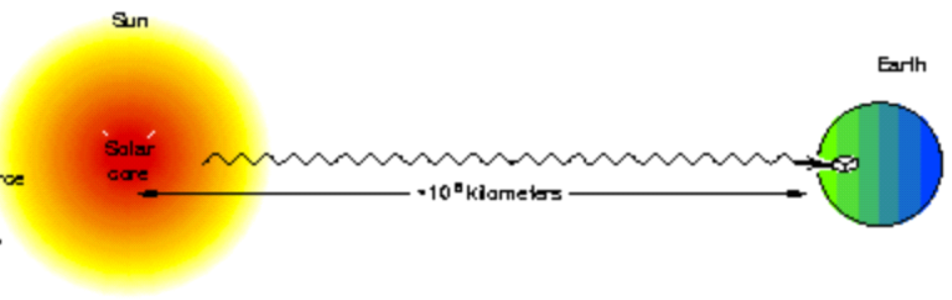
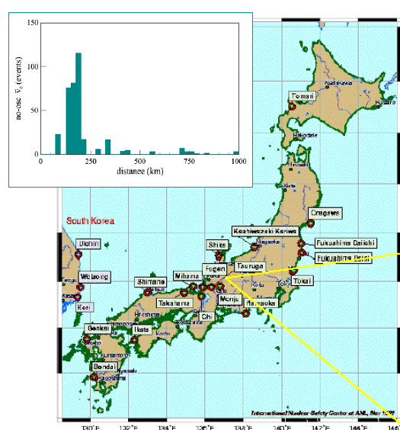
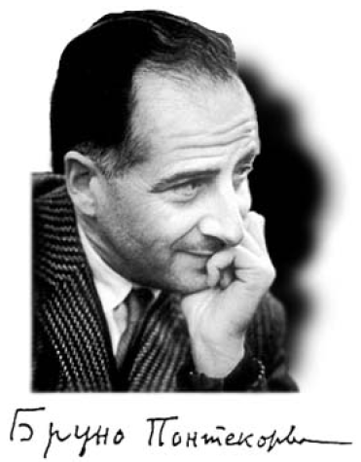
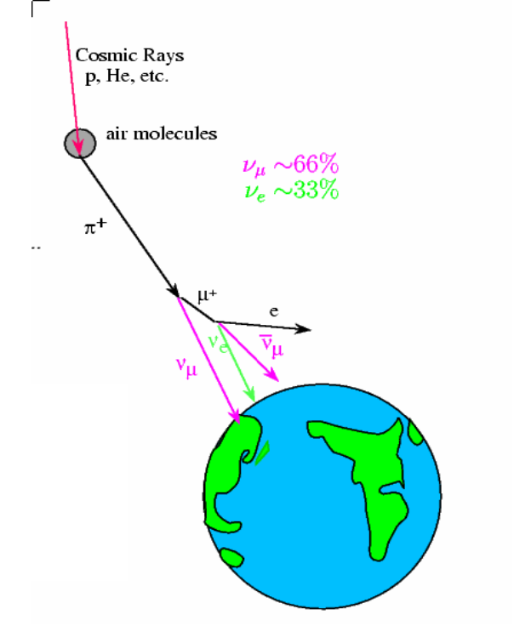
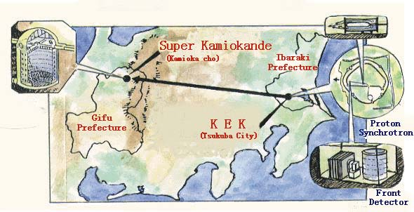
Observation of ν oscillations changed the world (of physics)
Reactor neutrinos
Solar neutrinos
1968
Atmospheric neutrinos
1957
Accelerator neutrinos
1998
SuperKamiokande

Slide 4
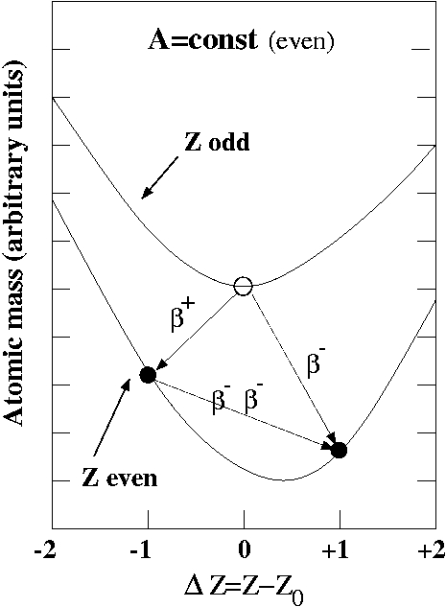
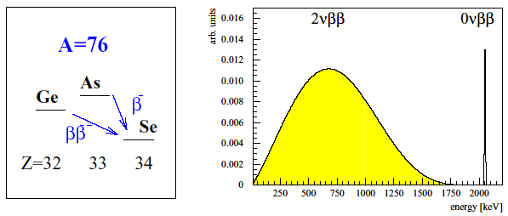
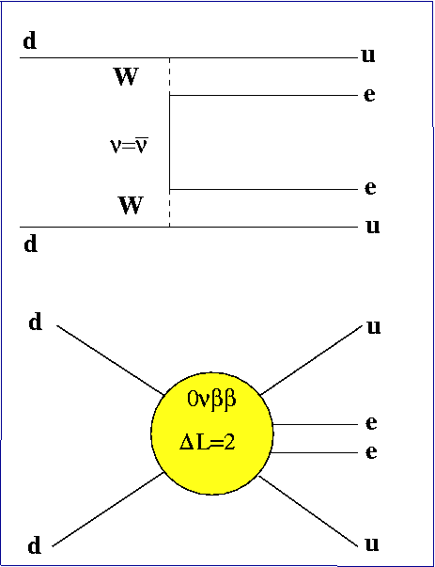
Double Beta Decay
Observed for 10 isotopes: ⁴⁸Ca, ⁷⁶Ge, ⁸²Se, ⁹⁶Zr,¹⁰⁰Mo.
¹¹⁶Cd. ¹²⁸Te, ¹³⁰Te, ¹⁵⁰Nd, ²³⁸U, T_{1/2} ≈10¹⁸-10²⁴ years
1967: ¹³⁰Te, Kirsten et al, Takaoka et al, (geochemical)
1987: ⁸²Se, Moe et al. (direct observation)
2006: ¹⁰⁰Mo, NEMO 3 coll. ~ 220 00 events
SM forbidden ,not observed yet: T_{1/2} ( ⁷⁶Ge)>10²⁵ years

Slide 5
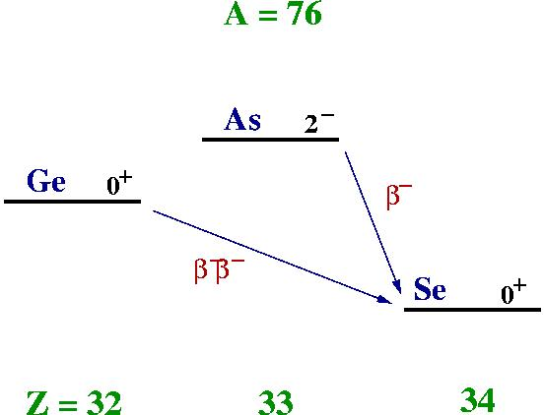
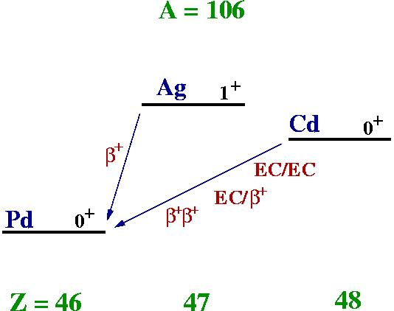
Different types
of
Double Beta Decay
Capture of bound e⁻ and
emission of e⁺ (EC/β⁺)
Emission of two e⁻ (β⁻β⁻)
T(MeV): ⁷⁶Ge(2.045), ⁸²Se(3.005),
¹⁰⁰Mo(3.033), ¹³⁰Te(2.533), ¹⁵⁰Nd(3.367)
T(MeV): ⁷⁸Kr(1.837), ¹⁰⁶Cd (1.724)
¹²⁴Xe(1.802), ¹³⁰Ba(1.515), ¹³⁶Ce(1.339)
Double capture of bound e⁻ (EC/EC)
Emission of two e+ (β⁺β⁺)
T(MeV): ⁷⁸Kr(2.841), ¹⁰⁶Cd (2.712)
¹²⁴Xe(2.782), ¹³⁰Ba(2.492), ¹³⁶Ce(2.313)
T(MeV): ⁷⁸Kr(0.838), ¹⁰⁶Cd (0.738)
¹²⁴Xe(1.024), ¹³⁰Ba(0.534), ¹³⁶Ce(0.362)
⇑ Disfavored by Coulomb repulsion ⇑

Slide 6
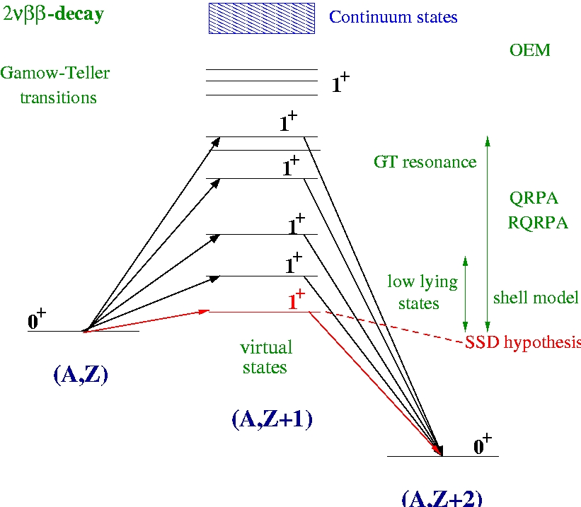

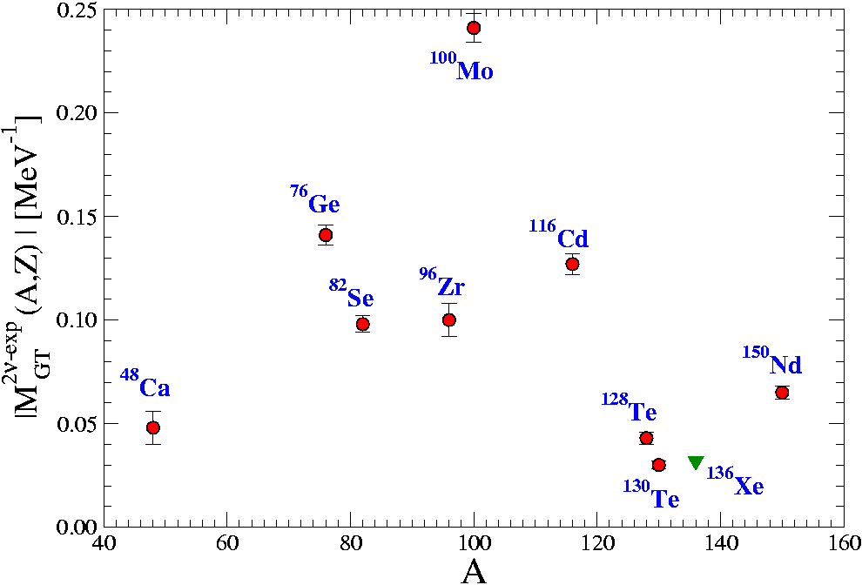
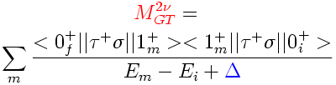
2νββ-decay
Nuclear Matrix Elements
Deduced from measured T_{1/2}^{2ν}
difference: by factor ~ 10

Slide 7
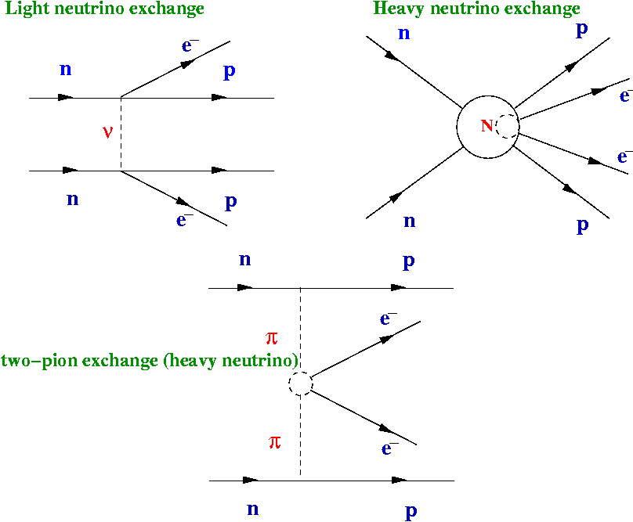


0νββ−decay
Nuclear Matrix Elements
Nuclear
Matrix
Elements
Shell model
QRPA …
NME´s: which mechanism, which transition?
It is a complex task
Medium and heavy open shell nuclei with a
complicated nuclear structure
The construction of complete set of the states of the
intermediate nucleus is needed
Many-body problem ⇒ approximations needed
Nuclear structure input has to be fixed

Slide 8


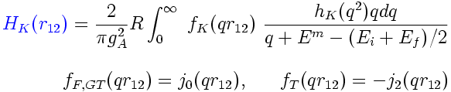
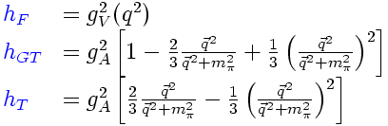
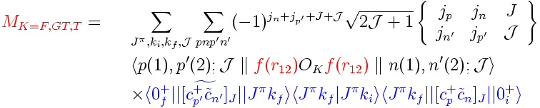
Calculation of the 0νββ-decay NME (light ν exchange mech.)
T
The 0νββ-decay half-life
NME= sum of Fermi, Gamow-Teller
and tensor contributions
Neutrino potential
Induced pseudoscalar
coupling
Form-factors:
Jastrow f.

Slide 9
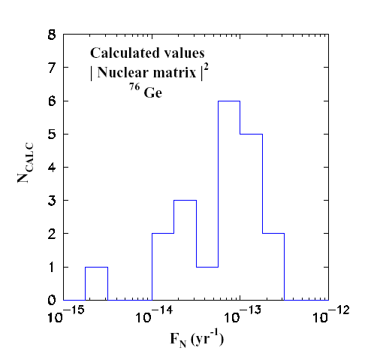
Particle physicists are interested
in NME´s
absolute ν mass scale
CP violating Majorana phases
Uncertainties in 0νββ−decay NME?
This suggest an uncertainty
of NME as much as factor 5
Is it really
so bad?!
Bahcall, Murayama, Pena-Garay,
Phys. Rev. D 70, 033012 (2004)

Slide 10
Nuclear structure approaches
H Ψ = Ε Ψ
We can not solve the full problem in the complete
Systematical study of the 0νββ-decay NME
Projected mean field (Vampir)
●Tomoda, Faessler, Schmid, Grummer, PLB 157, 4 (1985)
Shell model: ●Haxton, Stephensson, Prog. Part. Nucl. Phys. 12, 409(1984)
●Caurier, Nowacki, Poves, Retamosa, PRL 77, 1954 (1996)
• E. Caurier, E. Martinez-Pinedo, F. Nowacki, A. Poves, A. Zuker,
Rev. Mod. Phys. 77, 427 (2005).
QRPA, RQRPA: About 10 papers 1987→ 2006
Other approaches:
Shell Model Monte Carlo (1996), Operator Expansion Method (1988-1994)...

Slide 11
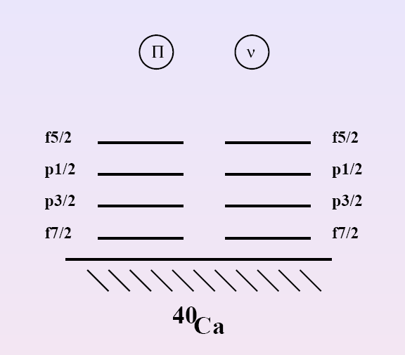
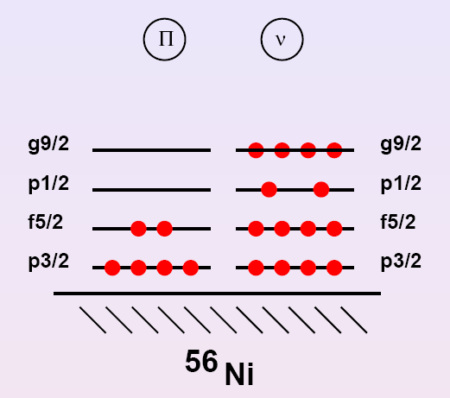
Shell Model
•Define a valence space
•Derive an effective interaction H Ψ = Ε Ψ → H_{eff} Ψ_{eff} = E Ψ_{eff}
•Build and diagonalize Hamiltonian matrix (10¹⁰)
•Transition operator < Ψ_{eff} | O_{eff} | Ψ_{eff}>
Some phenomenological input needed
energy of states, systematics of B(E2) and GT transitions (quenching f.)
⁴⁸Ca → ⁴⁸Ti
⁷⁶Ge → ⁷⁶Se
⁷⁶Se₄₂ in the valence
6 protons and 14 neutrons
Small calculations

Slide 12
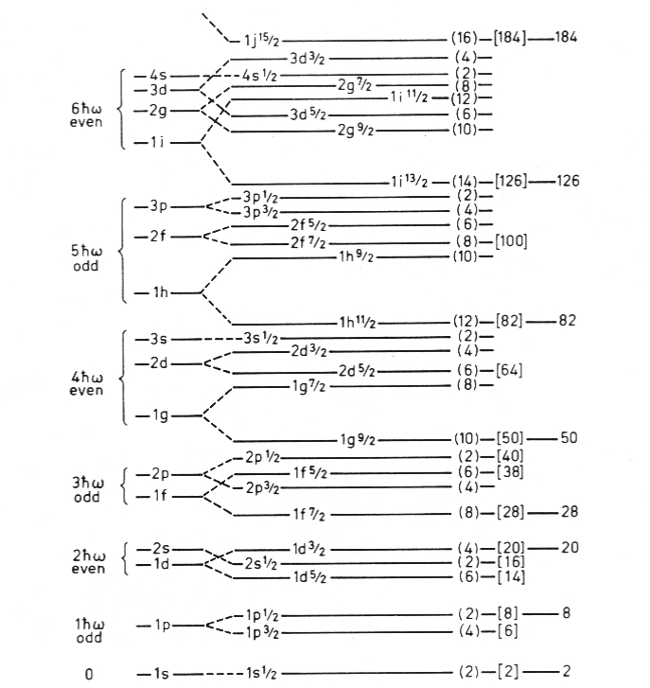
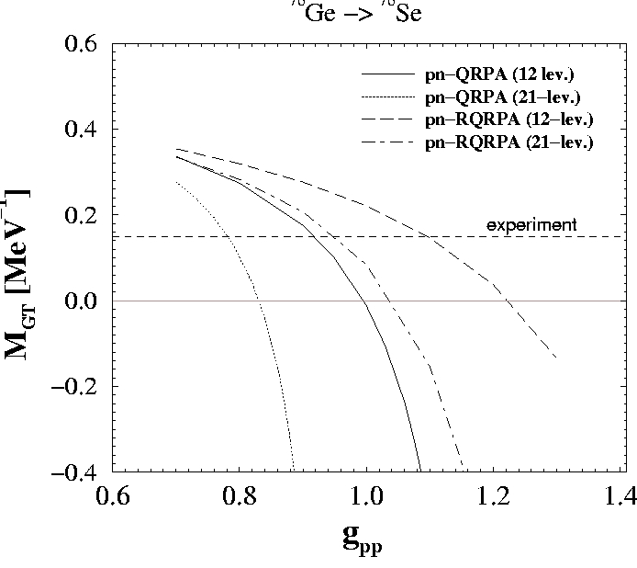
QRPA
2νββ-decay NME
H = H₀ + g_{ph} H_{ph} + g_{pp} H_{pp}
21 lev.
12 lev.
Collapse of the QRPA
21 l.m.s. 12 l.m.c

Slide 13
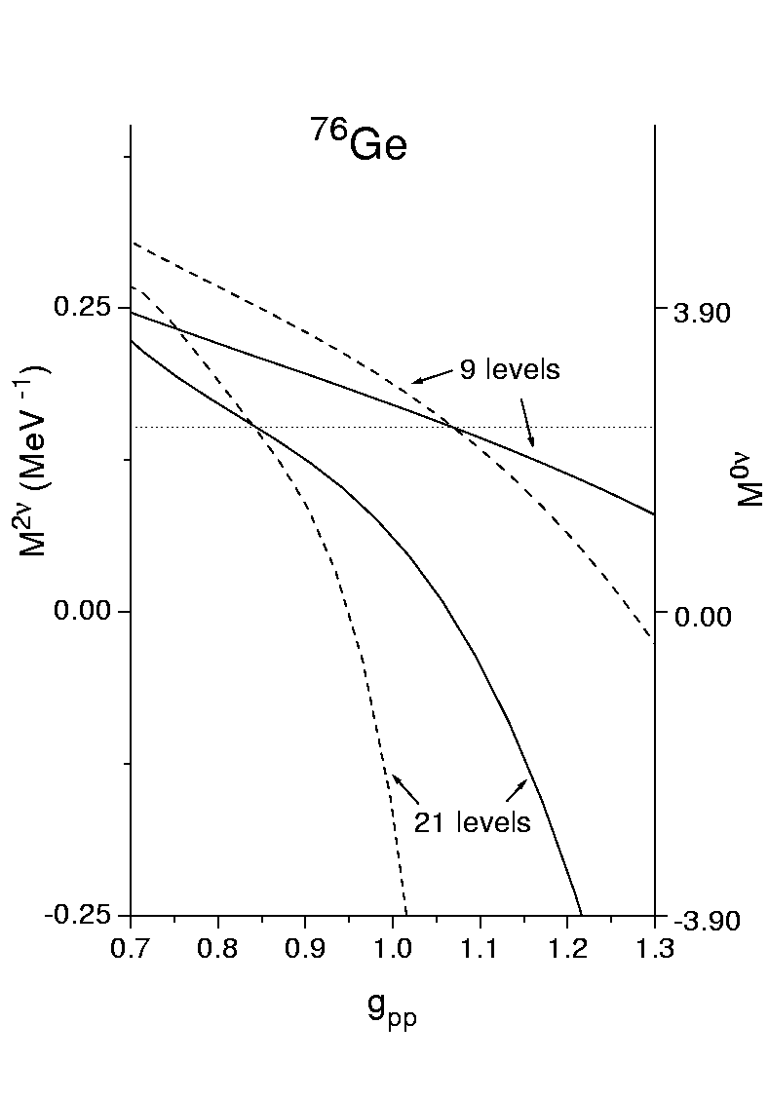
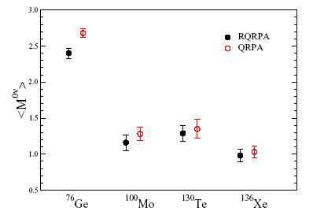
The 0νββ-decay NME: g_{pp} fixed to 2νββ-decay
Each point: (3 basis sets) x (3 forces) = 9 values
By adjusting of g_{pp} to 2νββ-decay half-life
the dependence of the 0νββ-decay NME on
other things that are not a priori fixed
is essentially removed
Rodin, Faessler, Šimkovic,Vogel,
Phys. Rev. C 68, 044302 (2003)

Slide 14
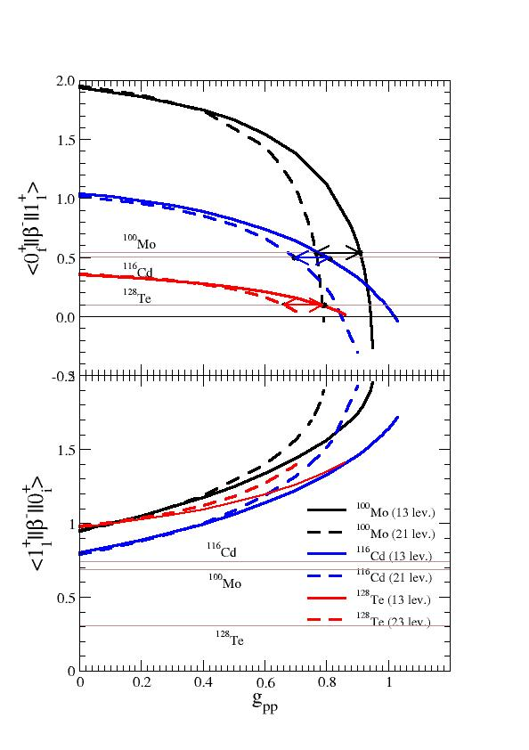
g_{A}=1.25
It is not possible to describe
simultaneously both β⁺/EC
and β⁻ decays:
move with g_{pp} in opposite
directions
only one free parameter and
two physical quantities
the role of overlap factor
ignored
(A,Z+1)→(A,Z+2)
(A,Z)→(A,Z+1)
But the lowest 1⁺ state is not
the only responsible for double
beta decay

Slide 15
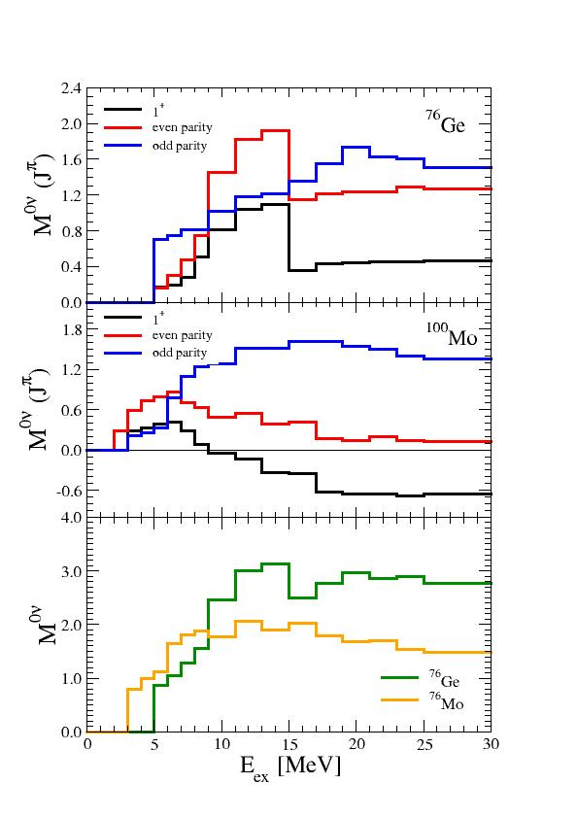
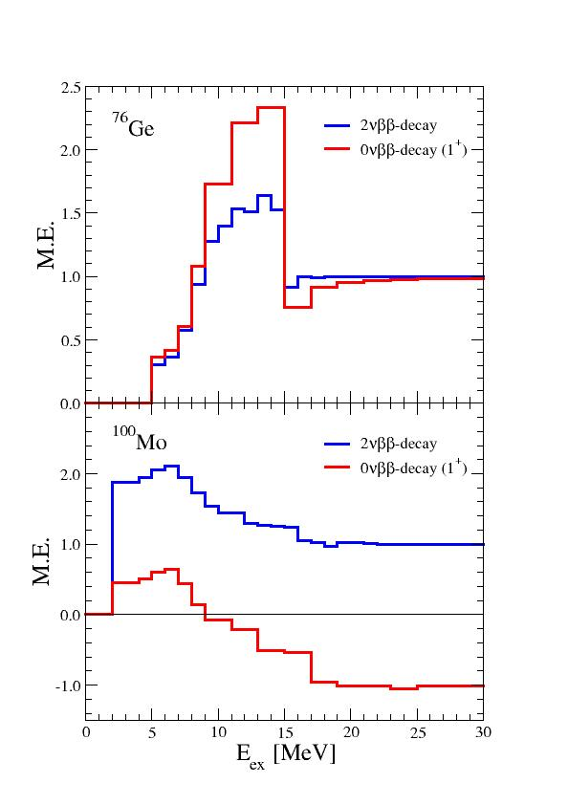
The importance of transition through higher-lying states of (A,Z+1) nucleus
Rodin,Faessler, Šimkovic, Vogel, nucl-th/0503063

Slide 16
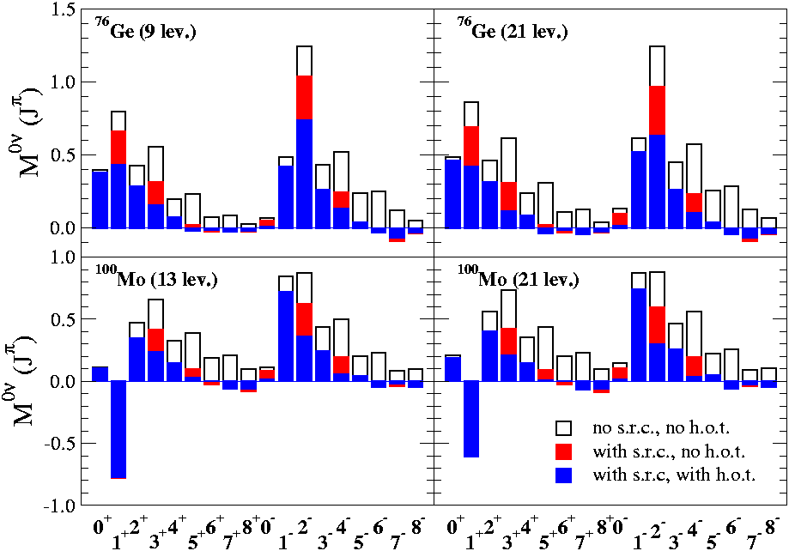
Suppression of higher multipolarities due to
two-nucleon short-range correlations
induced pseudoscalar coupling

Slide 17
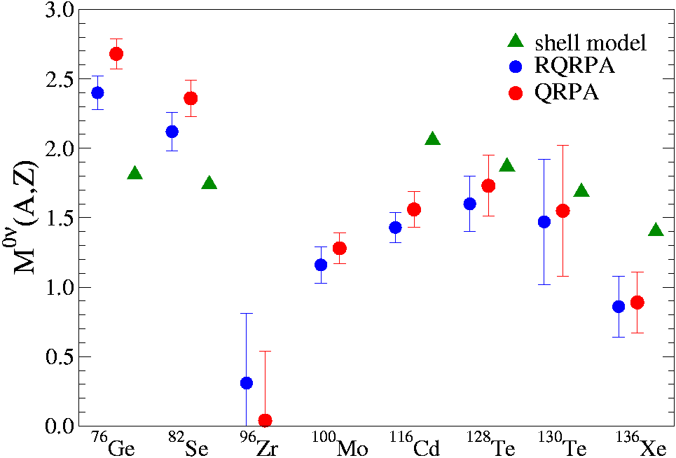
Neutrinoless Double Beta Decay Nuclear Matrix Elements
Light Majorana Neutrino Exchange Mechanism
QRPA, RQRPA: V.Rodin, A. Faessler, F. Š., P. Vogel, NPA 766 (2006) 107
shell model: E. Caurier, E. Martinez-Pinedo, F. Nowacki, A. Poves, A. Zuker,
Rev. Mod. Phys. 77, 427 (2005).

Slide 18
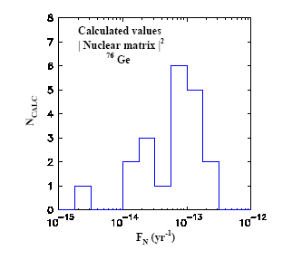
The outliers predict wrong 2νββ halflife. The matrix elements of SM
and Rodin et al. are quite close.
SRQRPABobyk 2001
2ν wrong 20x
SM 96
Caurier
QRPA
Rodin
2003
Tomoda 86
proj.m.f.
2ν wrong
6x

Slide 19
The 0νββ−decay NME within SRQRPA
Particle number condition
i) Uncorrelated BCS ground state
Pauli exclusion principle
i) violated (QBA)
Z=<BCS|Z|BCS>
[A,A⁺] =<BCS|[A,A⁺]|BCS>
N=<BCS|N|BCS>
QRPA
QRPA, RQRPA
ii) Correlated RPA ground state
ii) Partially restored (RQBA)
Z=<RPA|Z|RPA>
[A,A⁺] =<RPA|[A,A⁺]|RPA>
N=<BCS|N|BCS>
SRQRPA
RQRPA, SRQRPA
Complex numerical procedure
BCS and QRPA equations are coupled

Slide 20
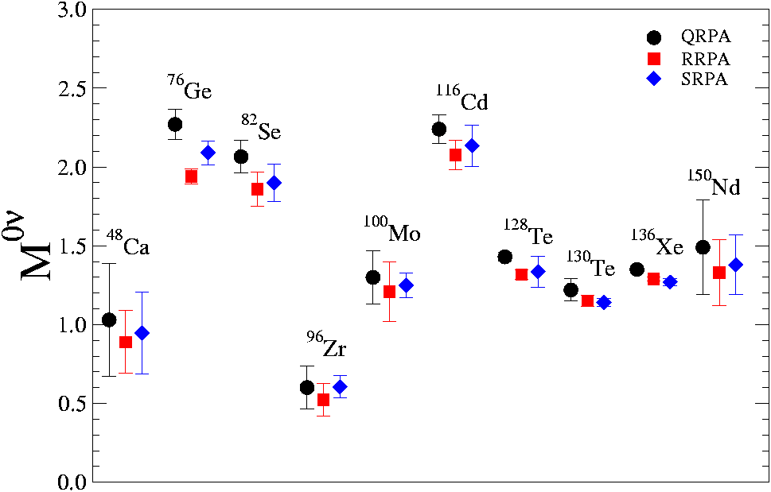
SRQRPA results
P. Beneš, F.Š., Faessler, Kaminski, Bobyk, in preparation
Pairing fixed to exp. pairing gaps (constant pairing considered)
BCS overlap factor taken into account
uncertainties of 2νββ-decay half-lives not considered

Slide 21
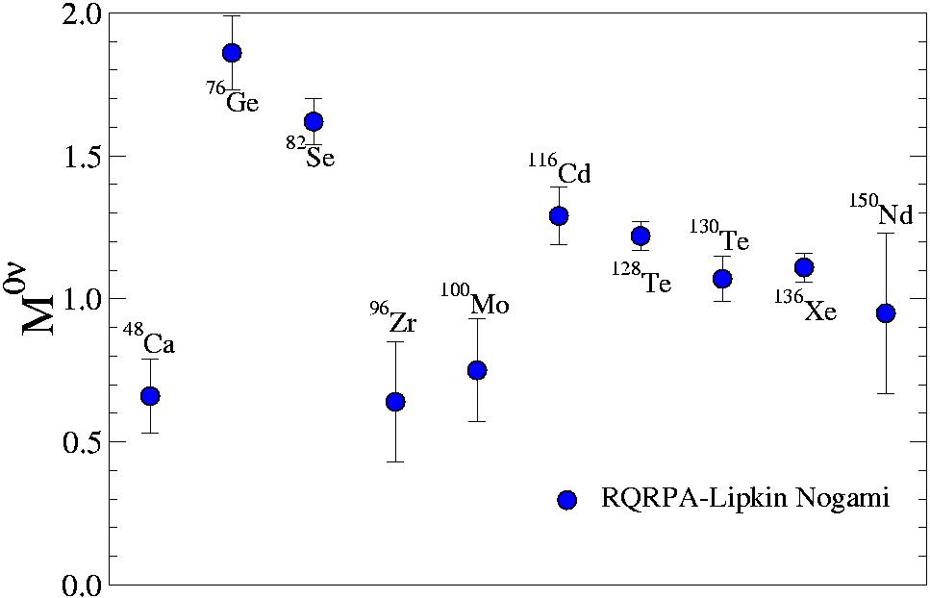
Lipkin-Nogami BCS ground state
(Partially) closed shell nuclei: ⁴⁸Ca, ¹¹⁶Sn, ¹³⁶Xe

Slide 22
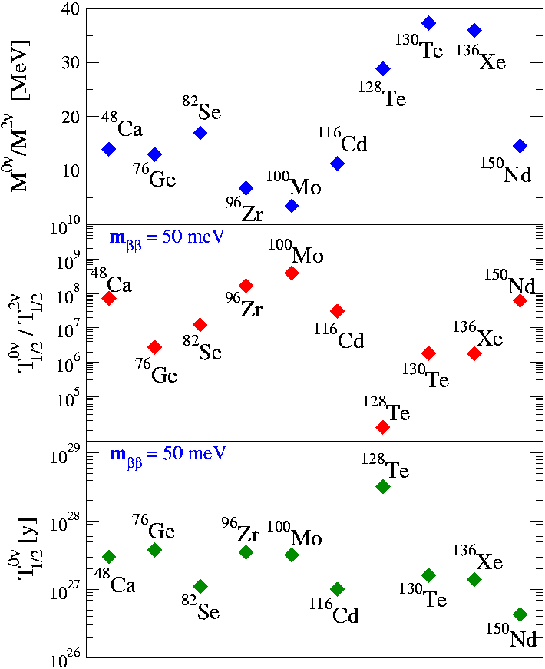
Ratios of NME and T_{1/2}
There is no scaling
Small value preferable
(2νββ-decay background)
Small value preferable
(sensitivity to 2νββ-decay
signal)

Slide 23
Additional uncertainties in 0νββ−decay NME
have to be understood
Short range correlations
QRPA overlap factor
Deformation of nuclei

Slide 24
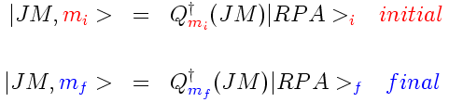
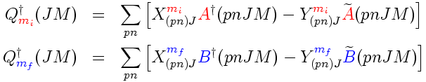

The overlap factor
Two sets of states
Phonon operators
Unitary transformation
between quasiparticles

Slide 25

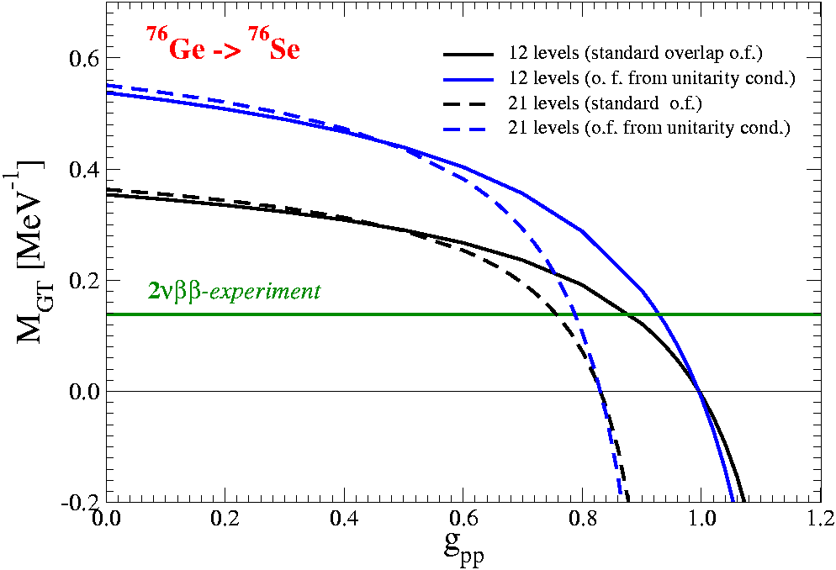
Unitarity violation

Slide 26
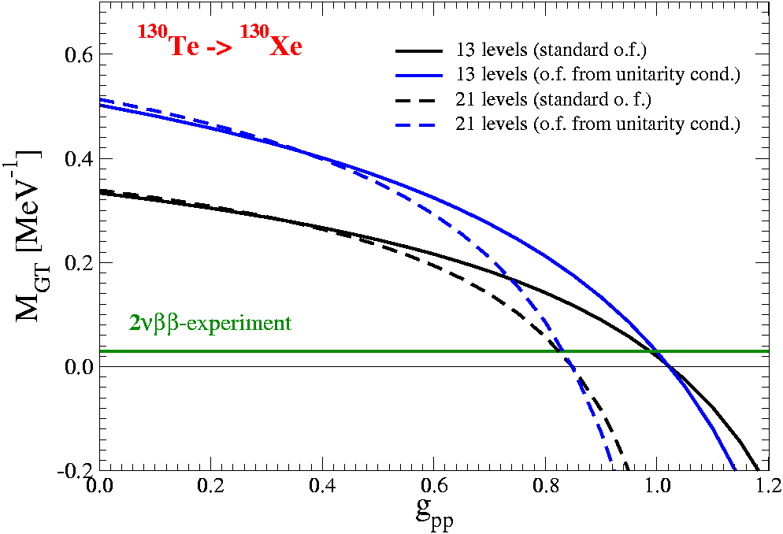
Unitarity violation

Slide 27
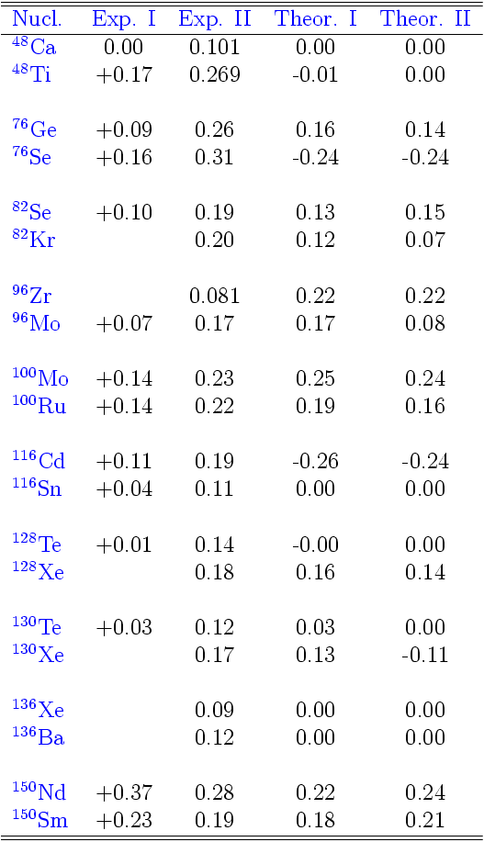

Nuclear deformation?
Exp. I (nuclear reorientation method)
Exp.II (based on measured E2 trans.)
Theor. I (Rel. mean field theory)
Theor. II (Microsc.-Macrosc. Model of
Moeller and Nix)
Till now, in the QRPA-like calculations
of the 0νββ-decay NME
spherical symetry was assumed
The effect of deformation on NME
has to be considered

Slide 28
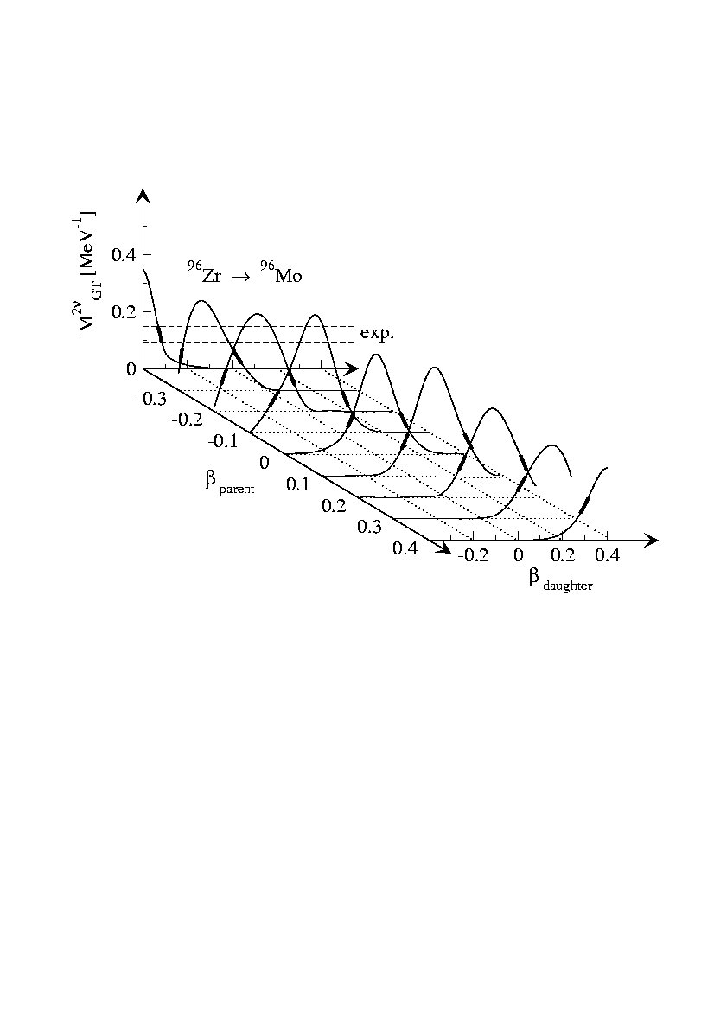
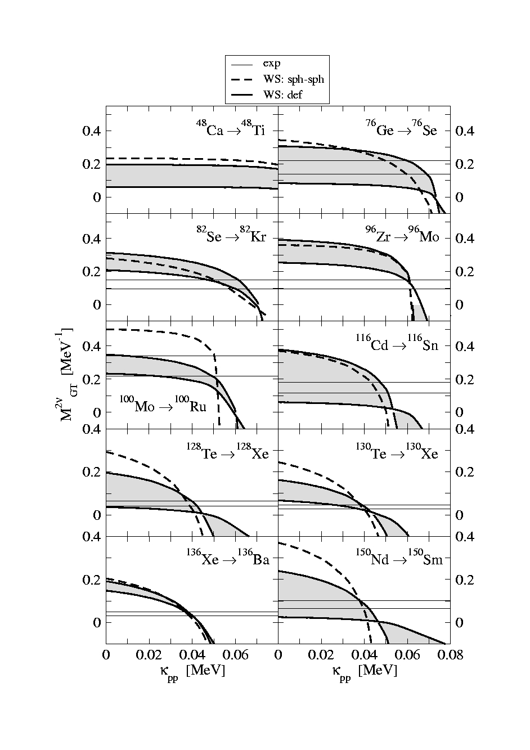
New Suppression Mechanism of the DBD NME
The suppression of the NME depends on
relative deformation of initial and final nuclei
Šimkovic, Pacearescu, Faessler.
NPA 733 (2004) 321
Systematic study of the deformation effect on
the 2νββ-decay NME within deformed QRPA
Alvarez,Sarriguren, Moya,Pacearescu, Faessler, Šimkovic,
Phys. Rev. C 70 (2004) 321

Slide 29
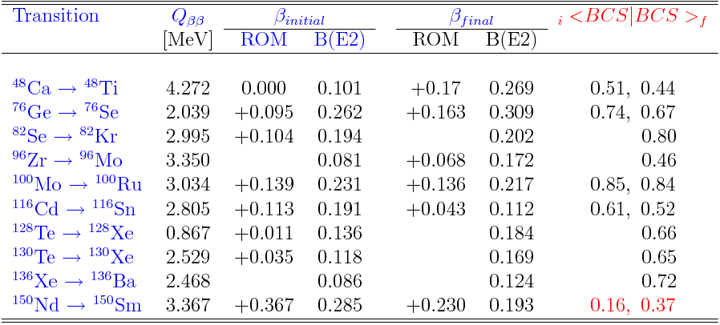
Estimation of the effect of the deformation
on the 0νββ-decay NME´s

Slide 30

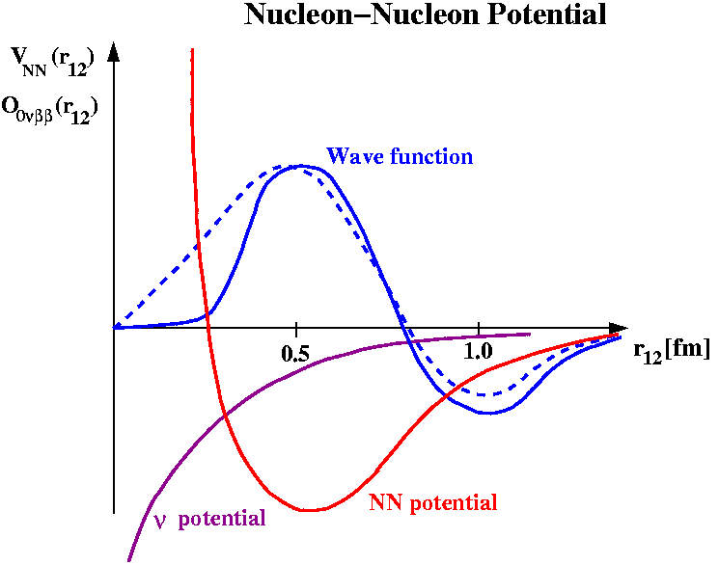
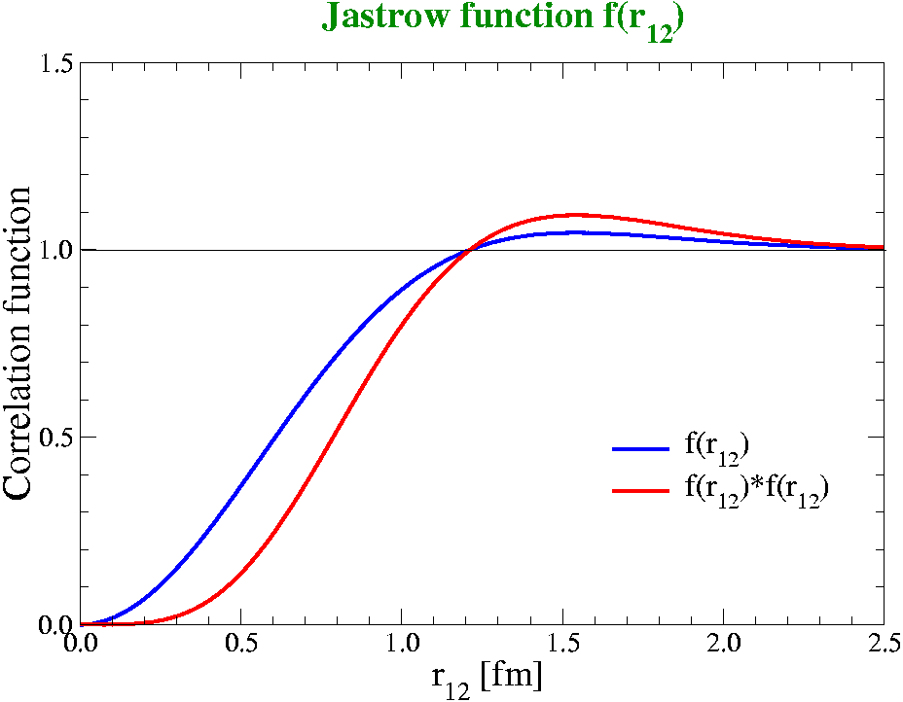
Two-nucleon short range correlations:

Slide 31

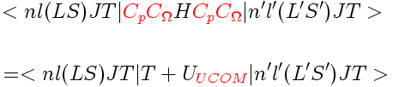


0νββ-decay NME with UCOM s.r.c.
Korteleinen, Civitarese, Suhonen, Toivanen,
nucl-th/0701052
Feldmeier et al.: UCOM corelations
introduce correlations by means of a unitary transformation
with respect to the relative coordinate of all pairs
UCOM correlations:
determined by two-body energy minimization
V_{UCOM} and V_{bare} are phase shift equivalent

Slide 32
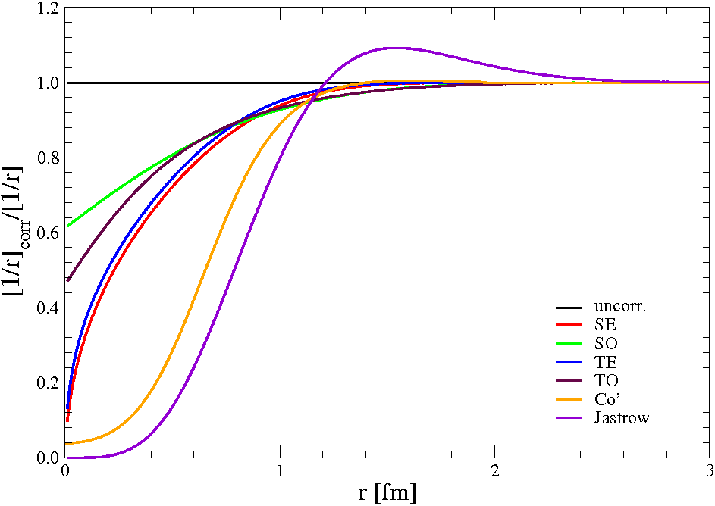
Comparison of UCOM and Spencer-Miller (Jastrow) s.r.c.
UCOM

Slide 33

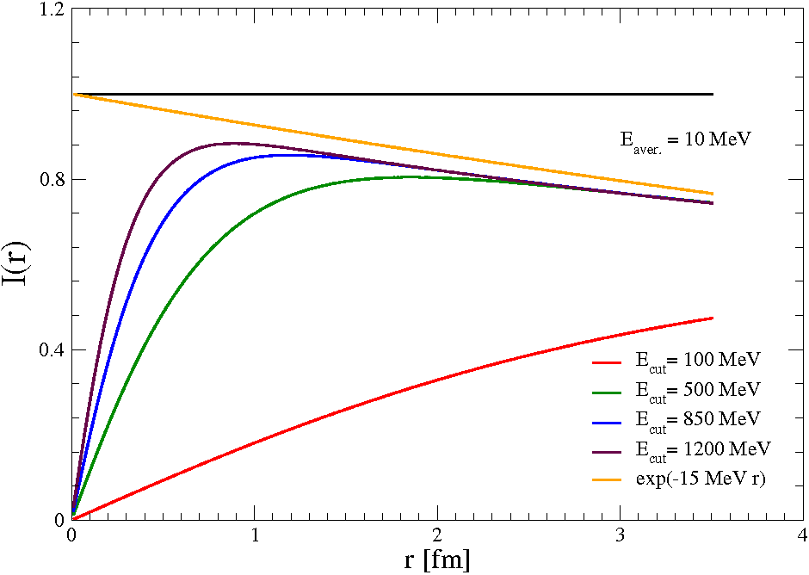
Finite nucleon size (formfactors) versus short range correlations.

Slide 34
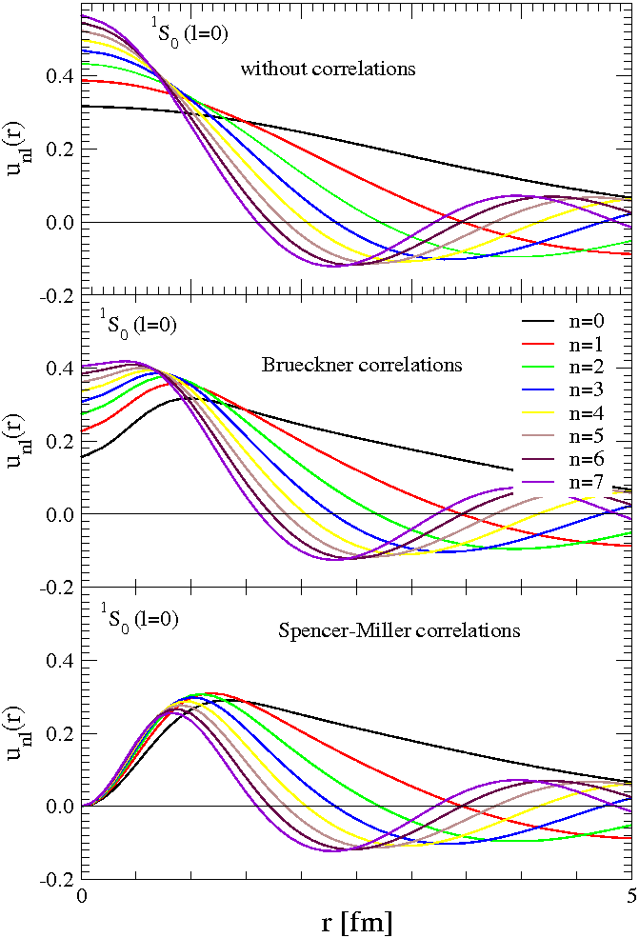

Two-body correlated wave function
Numerical solution of
Bethe-Goldstone equation
H. Muether et al.
Collaboration with
A. Faessler (Tuebingen)

Slide 35
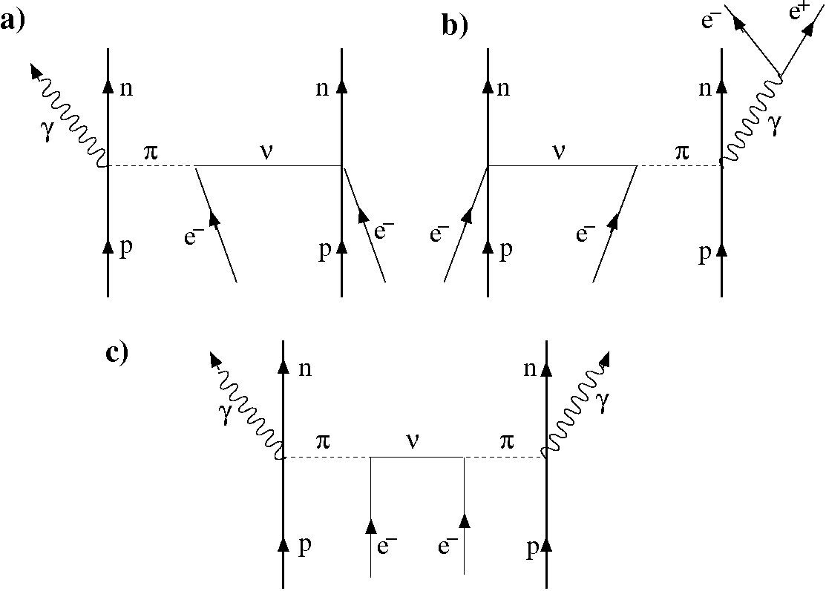
Neutrinoless double electron capture
Modes of the 0νECEC-decay:
e_{b} + e_{b}+ (A,Z) → (A,Z-2) + γ
+ 2γ
+ e⁺e⁻
+ Μ
Nuclear physics mechanisms:
γ from the nucleus
Theoretically,
not well understood yet:
which mechanism is important?
which transition is important?
in comparison with the 0νββ-decay
disfavoured due:
process in the 3-rd (4th) order
in electroweak theory
bound electron wave functions
favoured due:?

Slide 36
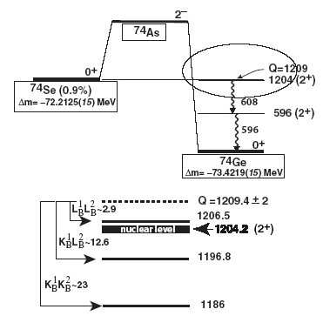
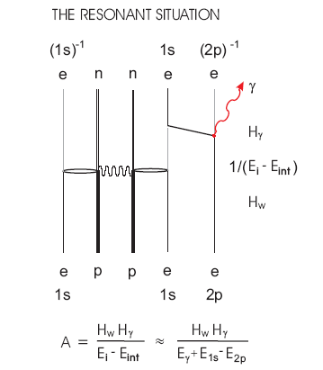


ECEC-γ decay
e_{b} + e_{b}+ (A,Z) → (A,Z-2) + γ
⇒
D.Frekers, hep-ex/0506002
Sujkowski, Wycech, PRC 70, 052501 (2004)
GERDA
%: 0.337
Q=0.433 MeV
Γ^{r}=100 eV
T_{1/2}^{0νγ} = 5 10³⁴ years (<m_{ββ}>=1eV)

Slide 37


e_{b} + e_{b}+ (A,Z) → (A,Z-2) + γ + γ
ECEC-γγ decay (preliminary)
Advanteges: - both e_{b} in 0s_{1/2} states (K-orbit)
- large Q values prefarable
- 1/(m_{e}(ε_{0s} + k₀)) enhancement
Disadvantages: - 2 γ´s in final state (phase space)
- additional el.-mag. interaction
<m_{ββ}>=1eV:
T_{1/2}^{0νγγ} (³⁶Ar) = 5 10³⁴ years
T_{1/2}^{0νγγ} (¹⁰⁶Cd) = 9 10³² years
T_{1/2}^{0νγγ} (¹⁶²Er) = 7 10³² years
Carefull study study (Merle, Lindner, Beneš, F.Š) in progress

Slide 38



A product of 0νββ−decay NME
Can you imagine 0νββ−decay of 4 nuclei (e.g. ⁷⁶Ge, ⁸²Se, ¹³⁰Te, ¹³⁶Xe) is observed …
Physical quantity of interest
uncertainty
Distinguishing different mechanisms
light neutrino exchange
heavy neutrino exchange
pion-exchange mech.
Observation of the 0νββ−decay of at least 3-4 different nuclei is needed

Slide 39
Conclusions and Outlook
The uncertainty in the calculated NME might be small (optimistic < 50 %)
[i) model size independent , nuclear structure input and nuclear model (QRPA,
RQRPA, SRQRPA) weakly dependent results,
ii) convergence of the NSM and the QRPA NME´s]
There is a small spread of the 0νββ-decay NME´s in comparison with the
2νββ-decay NME´s (no scaling)
Futher progress in calculation of the 0νββ-decay NME: The problems of the
QRPA overlap factor, nuclear deformation, short-range correlations will be
solved.
The 0νECEC-decay is not well understood yet. Theoretically, it is a problem
of particle, nuclear and atomic physics. Questions: which mode, which
mechanism, which transition?

Slide 40










What is the nature of neutrinos?
⇒
theory
Only the 0νββ-decay can answer this fundamental question
By product:
Absolute ν mass scale
CP Majorana phases
●●●

